Slide 1
Vygotsky: Social Learning Theory
Rachel Ostrye
Colleen Brieck
Lauren Rockwell

Slide 2
Background: Lev Vygotsky
Lev Vygotsky (1896-1934) Russian/Soviet psychologist
Founder of "cultural-historical psychology"
His main work: developmental psychology
Vygotsky's theories were viewed as controversial in the Soviet Union during his lifetime
His theories spread to the U.S. around the 1970's and became highly regarded and influential within the realm of developmental psychology
Vygotsky, Lev Semyonovich. (2008). Complete Dictionary of Scientific Biography. 2008. Retrieved July 16, 2013 from: http://www.encyclopedia.com/doc/1G2-2830906184.html

Slide 3
Vygotsky's View of the Learner
The child is viewed as an active seeker of knowledge
The mind is socially constructed
The child is born with basic attentional, perceptual and memory capacities
Development occurs as a direct result of contact with the environment
Child as self communicator – leads to higher order thinking
Language and thought develop independently, but eventually merge and interact
McLeod, S. A. (2007). Vygotsky - Simply Psychology. Retrieved from http://www.simplypsychology.org/vygotsky.html

Slide 4
Social Interaction
Vygotsky believed that children are curious and driven toward being actively involved in their exploration of learning
Much of this learning takes place through social interactions
Learning is cooperative or
collaborative in nature
McLeod, S. A. (2007). Vygotsky - Simply Psychology. Retrieved from http://www.simplypsychology.org/vygotsky.html

Slide 5
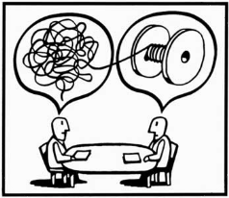
More Knowledgeable Other (MKO)
Definition: Someone who has a better understanding or is of a higher ability level than the learner
Does not have to be a teacher or adult
This individual can aid the
cognitive development of
the learner
McLeod, S. A. (2007). Vygotsky - Simply Psychology. Retrieved from http://www.simplypsychology.org/vygotsky.html

Slide 6
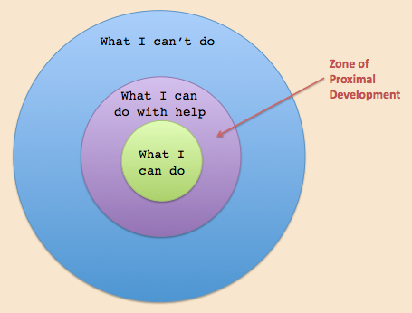
Zone of Proximal Development (ZPD)
Definition: The range between what a child can achieve independently and what a child can achieve with the guidance and support of a teacher or MKO
Learning occurs just above the student's current level of competence
In teacher terms:
"Instructional Level"
McLeod, S. A. (2007). Vygotsky - Simply Psychology. Retrieved from http://www.simplypsychology.org/vygotsky.html

Slide 7
Current Perspectives
Schreiber and Valle (2013) use Vygotsky's Social Learning Theory as their foundation for teaching small group and teamwork principles.
They focus on complex and interactive relationships of learning, rather than a "teaching-listening relationship".
Schreiber and Valle also bring about the issue that group work cannot just be assigned and take place, it needs to be appropriately modeled and scaffolded.
In order to truly apply Vygotsky's theory and perspectives, students must first experience small group communication and behavior in authentic and realistic-to-life scenarios.
These first steps in developing small group communication should focus in on interaction skills and problem solving.
Schreiber, L. M., & Valle, B. E. (2013). Social constructivist teaching strategies in the small group classroom. Small Group Research, 44(4), 395-411.

Slide 8
Current Perspectives
A child's learning should be directed towards their immediate potential for development - Zone of Proximal Development (ZPD)
Effective ZPD leads to internalization of learning by student
Levykh (2008) states that factors needed for effective ZPD include:
Emotionally positive collaboration and sense of trust between teacher and student
Student belief that the teacher cares about them as a whole person
High expectations that are developmentally appropriate set by teachers
Collaborative, cooperative learning activities
Activities that trigger prior knowledge,
Environments that facilitate risk-taking behavior and acceptance of constructive criticism
Levykh, M. G. (2008). The affective establishment and maintenance of Vygotsky's zone of proximal development. Educational Theory, 58(1), 83-101.
Notes:
Levykh, M. G. (2008). The affective establishment and maintenance of Vygotsky's zone of proximal development. Educational Theory, 58(1), 83-101.

Slide 9
Current Perspectives
According to .. .there is no doubt that imagination is important to today's students and their learning process. Some schools seem to be missing the imagination part however and ..... suggests the reasons why teachers should not neglect the imagination.
Vygotsky claimed that students go through a huge imagination shift in the middle-school years. This shift not only affects students behaviors and personalities, but also their intellectual development and ways to make sense of the world.
Imagination is connected with meaning-making, emotions and intellectual functions.
Gajdamaschko, N. (2005). Vygotsky on imagination: Why an understanding of the imagination is an important issue for schoolteachers. Teaching Education, 16(1), 13-22.

Slide 10
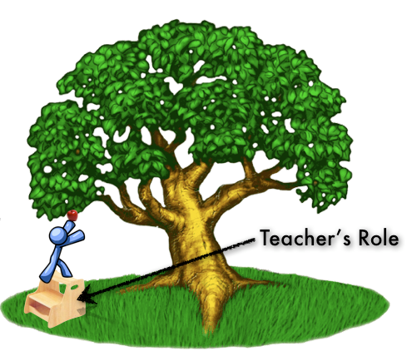
Teacher Implications
Teacher's should assist students in exploring their own learning
Teachers should guide learning through modeling and scaffolding.
Differentiate lessons to each student's zone of proximal development - "instructional level"
Students should be active in the learning process
Engage in teacher-to-student and student-to-student interactions and discourse.
Promote fantasy and exploratory play.
Utilize cooperative learning and reciprocal teaching strategies that include summarizing, questioning, clarifying, and predicting.

Slide 11
Reflections
Social and collaborative learning can be a great tool if utilized effectively. Teachers need to provide modeling and scaffolding, with a gradual release of responsibility.
Teacher must be present as a guide, helping to facilitate groups as needed.
Classroom community plays important role in learning
Learning occurs when teacher expectations are appropriate and student development
is considered
Value in assessing students to
determine appropriate instructional
level and ZPD

Slide 12
References
Gajdamaschko, N. (2005). Vygotsky on imagination: Why an understanding of the imagination is an important issue for schoolteachers. Teaching Education, 16(1), 13-22.
Levykh, M. G. (2008). The affective establishment and maintenance of Vygotsky's zone of proximal development. Educational Theory, 58(1), 83-101.
McLeod, S. A. (2007). Vygotsky - Simply Psychology. Retrieved from http://www.simplypsychology.org/vygotsky.html
Schreiber, L. M., & Valle, B. E. (2013). Social constructivist teaching strategies in the small group classroom. Small Group Research, 44(4), 395-411.
Vygotsky, Lev Semyonovich. (2008). Complete Dictionary of Scientific Biography. 2008. Retrieved July 16, 2013 from: http://www.encyclopedia.com/doc/1G2-2830906184.html

